Slide 1
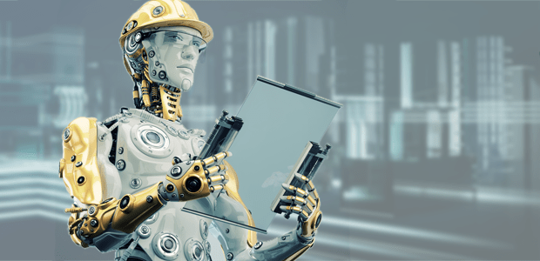

Multi-disciplinary Design Project Smartly Controlled Devices
Subject Incharge – Mr. Abhishek Sharma
Created By – Anurag Kumar Singh
RA1511003030394
CSE-G
Group ID - K

Slide 2
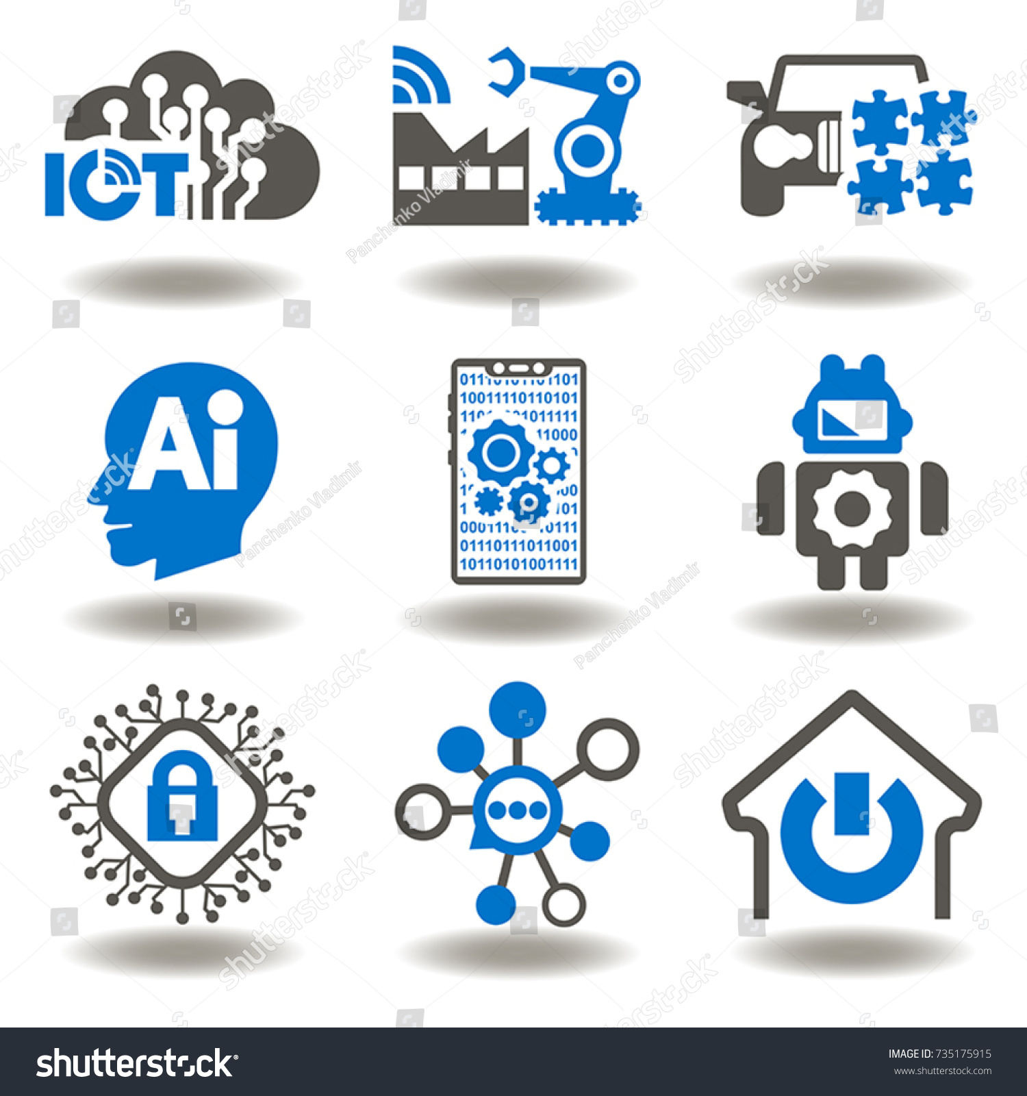
About
IoT
IoT is short for Internet of Things. The Internet of Things refers to the ever-growing network of physical objects that feature an IP address for internet connectivity, and the communication that occurs between these objects and other Internet-enabled devices and systems.
The Internet of Things term is coined by Kevin Ashton in 1999.
According to Cisco Internet Business Solutions Group (IBSG), the Internet of Things was born in between 2008 and 2009 at simply the point in time when more “things or objects” were connected to the Internet than people.
Experts estimate that the IoT will consist of about 30 billion objects by 2020.
Home Automation
Home automation gives you access to control devices in your home from a mobile device anywhere in the world.
Home automation is a step toward what is referred to as the "Internet of Things," in which everything has an assigned IP address, and can be monitored and accessed remotely.
Automation is, unsurprisingly, one of the two main characteristics of home automation. Automation refers to the ability to program and schedule events for the devices on the network.
Artificial Intellgence
The theory and development of computer systems able to perform tasks normally requiring human intelligence, such as visual perception, speech recognition, decision-making, and translation between languages.
A further step towards the development of modern AI was the creation of The Logic Theorist. Designed by Newell and Simon in 1955 it may be considered the first AI program.
The person who finally coined the term artificial intelligence and is regarded as the father of AI is John McCarthy.

Slide 3
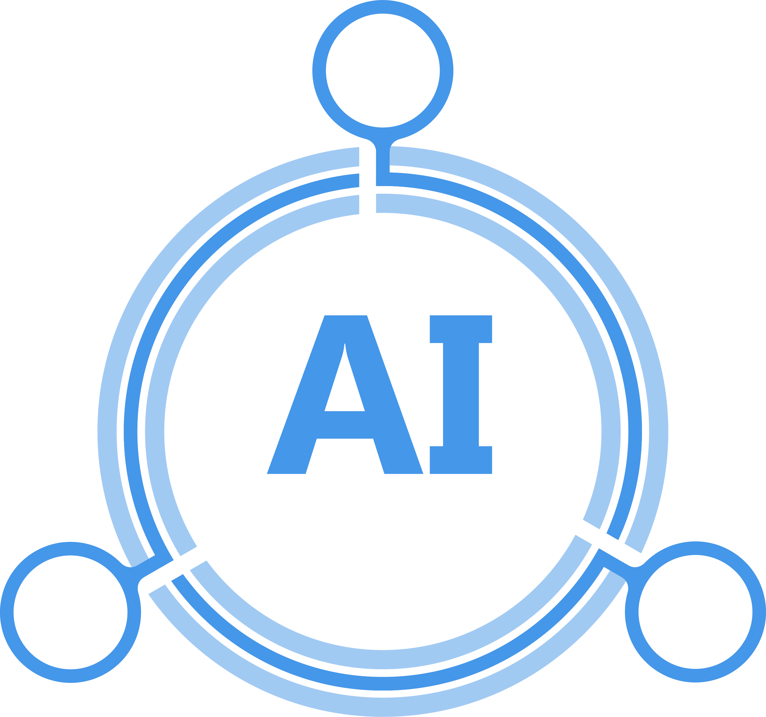
Introduction
Because of IoT our day to day devices are connected to a network.
Home automation is not a hypothetical concept now a days.
1st generation home automation
Wireless.
But still have to interact to the interface manually.
2nd generation home automation
A device containing an AI e.g. AMAZON echo.
3rd generation house automation
Interacting with a robot.
This project is based on 2nd generation house automation.
Any device which is connected to the internet and authorize to access can be controlled by the AI.
The AI will store all record about day to day life action.
It will be a faithful servant.
It will be a software which can be installed in any device e.g. smartphone, laptop.
An user can interact with the AI by voice or text as an input.
It will always run in background.
It can only be closed manually.

Slide 4

Requirement
Arduino UNO 3
HC – 05 Bluetooth Module
5V Relay X 4
Prototyping board (Bread board)
Jumper wires
Smartphone or tablet (Bluetooth enabled)
XAMPP
PHP
MIT app Inventor
Arduino Software(IDE)

Slide 5
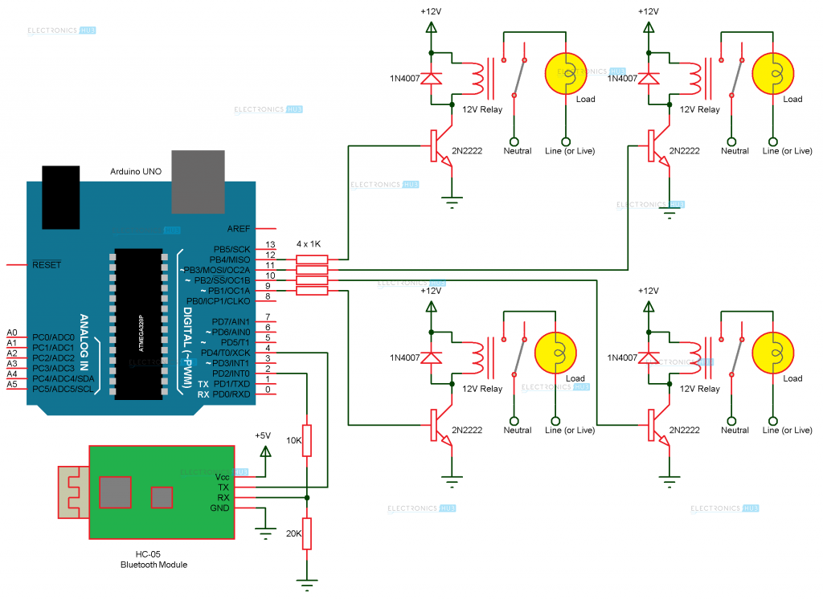
Circuit Diagram

Slide 6
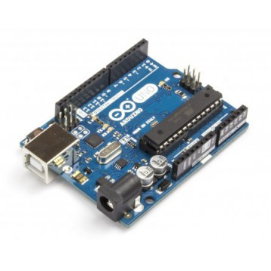
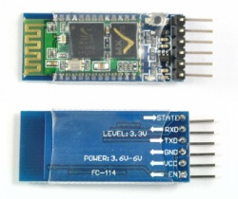
About Circuit
Arduino Uno is a microcontroller board based on the ATmega328P (datasheet). It has 14 digital input/output pins (of which 6 can be used as PWM outputs), 6 analog inputs, a 16 MHz quartz crystal, a USB connection, a power jack, an ICSP header and a reset button. It contains everything needed to support the microcontroller; simply connect it to a computer with a USB cable or power it with a AC-to-DC adapter or battery to get started..
HC‐05 module is an easy to use Bluetooth SPP (Serial Port Protocol) module, designed for transparent wireless serial connection setup. The HC-05 Bluetooth Module can be used in a Master or Slave configuration, making it a great solution for wireless communication. This serial port Bluetooth module is fully qualified Bluetooth V2.0+EDR (Enhanced Data Rate) 3Mbps Modulation with complete 2.4GHz radio transceiver and baseband. It uses CSR Blue core 04‐External single chip Bluetooth system with CMOS technology and with AFH (Adaptive Frequency Hopping Feature).

Slide 7
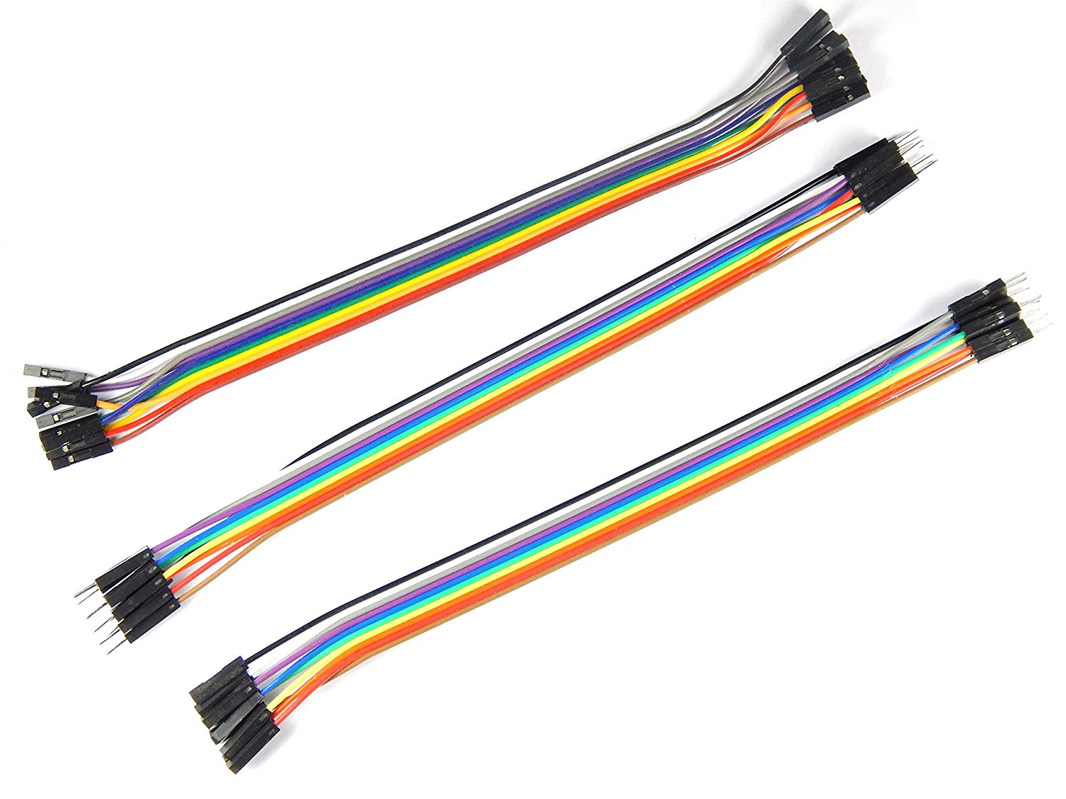
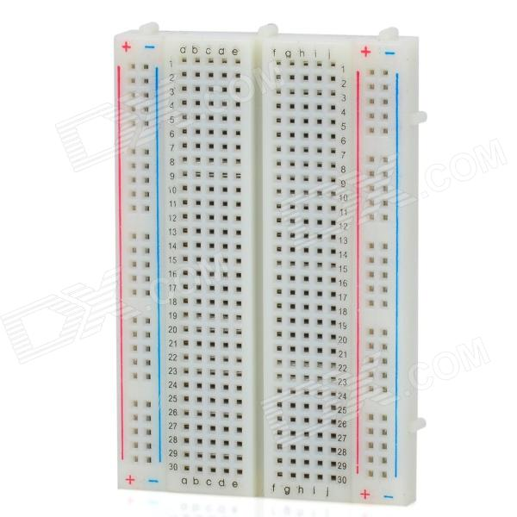
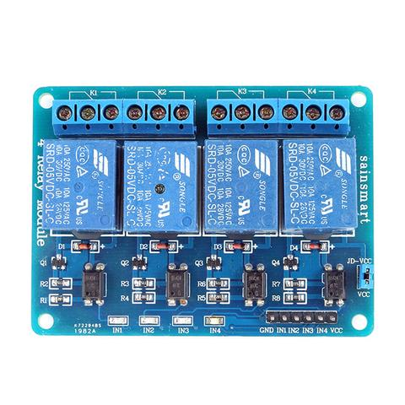
Jump wire (also known as jumper, jumper wire, jumper cable, DuPont wire, or DuPont cable – named for one manufacturer of them) is an electrical wire, or group of them in a cable, with a connector or pin at each end (or sometimes without them – simply "tinned"), which is normally used to interconnect the components of a breadboard or other prototype or test circuit, internally or with other equipment or components, without soldering.
Breadboard is a construction base for prototyping of electronics. Originally it was literally a bread board, a polished piece of wood used for slicing bread. In the 1970s the solderless breadboard (a.k.a. plug board, a terminal array board) became available and nowadays the term "breadboard" is commonly used to refer to these.
Because the solderless breadboard does not require soldering, it is reusable. This makes it easy to use for creating temporary prototypes and experimenting with circuit design. For this reason, solderless breadboards are also popular with students and in technological education. Older breadboard types did not have this property. A stripboard (Vero board) and similar prototyping printed circuit boards, which are used to build semi-permanent soldered prototypes or one-offs, cannot easily be reused.
This is a 5V 4-Channels Relay module, It can be controlled directly by a wide range of microcontrollers such as Arduino, AVR, PIC, ARM and MSP430.
4 relays are included in this module, with “NC” ports means “Normally connected to COM” and “NO” ports means “Normally open to COM”. This module also equipped with 4 LEDS to show the status of relays.

Slide 8
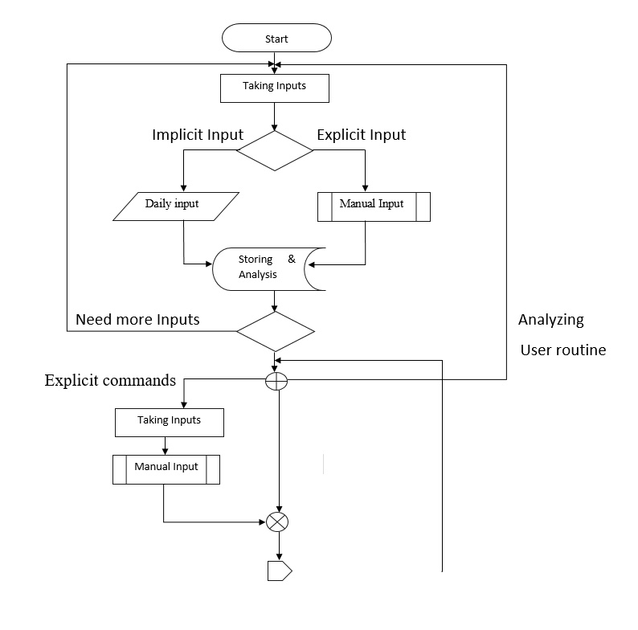
Flow Chart

Slide 9
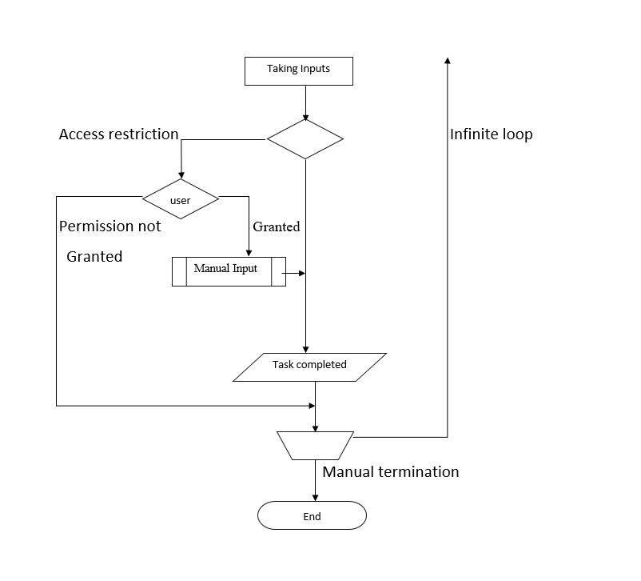

Slide 10
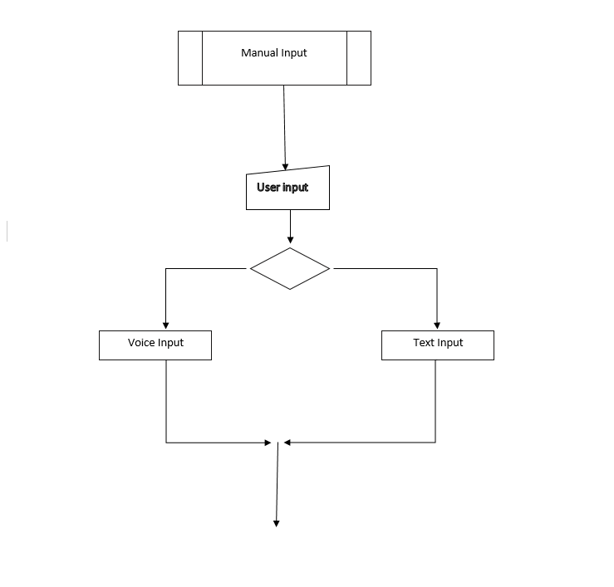

Slide 11




Software Details
The open-source Arduino Software (IDE) makes it easy to write code and upload it to the board. It runs on Windows, Mac OS X, and Linux. The environment is written in Java and based on Processing and other open-source software.
XAMPP stands for Cross-Platform (X), Apache (A), Maria DB (M), PHP (P) and Perl (P). It is a simple, lightweight Apache distribution that makes it extremely easy for developers to create a local web server for testing and deployment purposes.
MIT App Inventor for Android is an open-source web application originally provided by Google, and now maintained by the Massachusetts Institute of Technology (MIT).
It allows newcomers to computer programming to create software applications for the Android operating system (OS). It uses a graphical interface, very similar to Scratch and the Star Logo TNG user interface, which allows users to drag-and-drop visual objects to create an application that can run on Android devices.
The PHP Hypertext Preprocessor (PHP) is a programming language that allows web developers to create dynamic content that interacts with databases. PHP is basically used for developing web based software applications.

Slide 12
Time Line Diagram
January – Collecting related information and developing a rough idea
February – Creating prototype
March – AI development
April – Testing and debugging

Slide 13

Conclusion
Artificial Intelligence are started to become most important topic for this era, there are many benefits of this, and it ease the workload of the human. Using smart gadgets comes with high utilization of electricity. Because we have to take action manually through some another devices like smart phones. Human makes mistake and sometimes forget to turn off devices, this is prevented by using an AI which take care and also provides the statistics and also warns and take action of its own. And of course save electricity more than a human. But as we know making a perfect AI is still on progress because perfection need time, world is changing and the era of AI is coming where every objects somehow will connected to the AI. There are many advantages but disadvantages too. Thus we have to handle AI with caution.

Slide 14
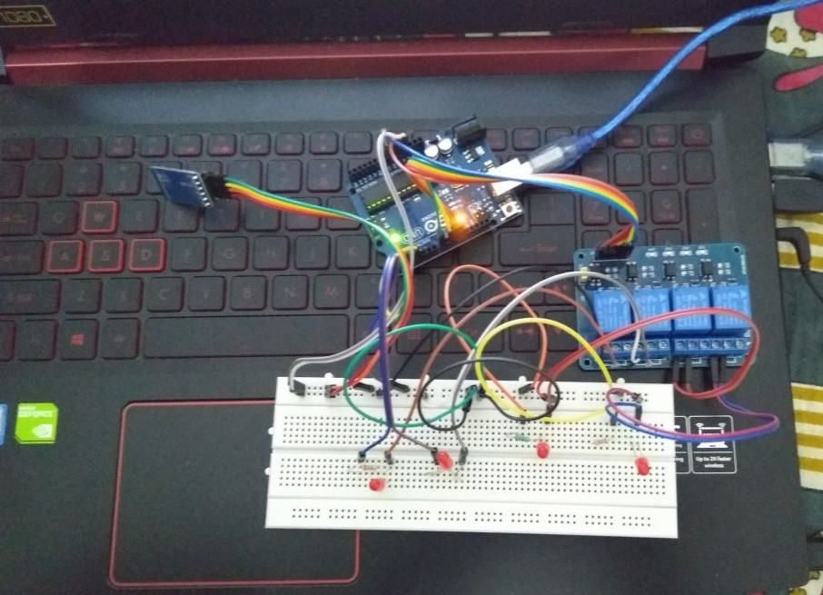
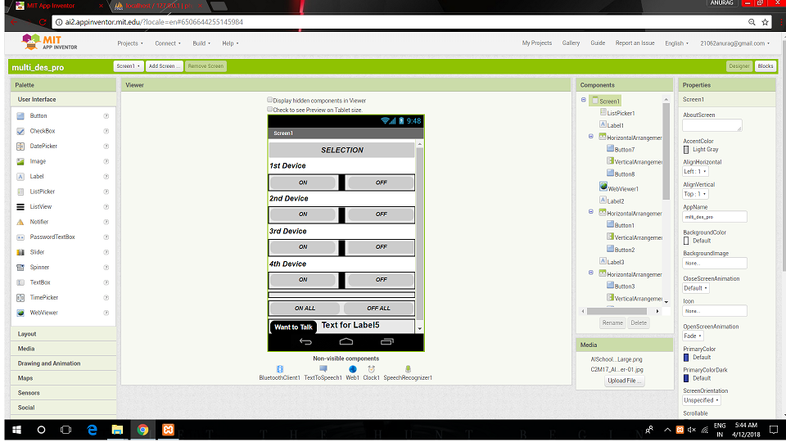
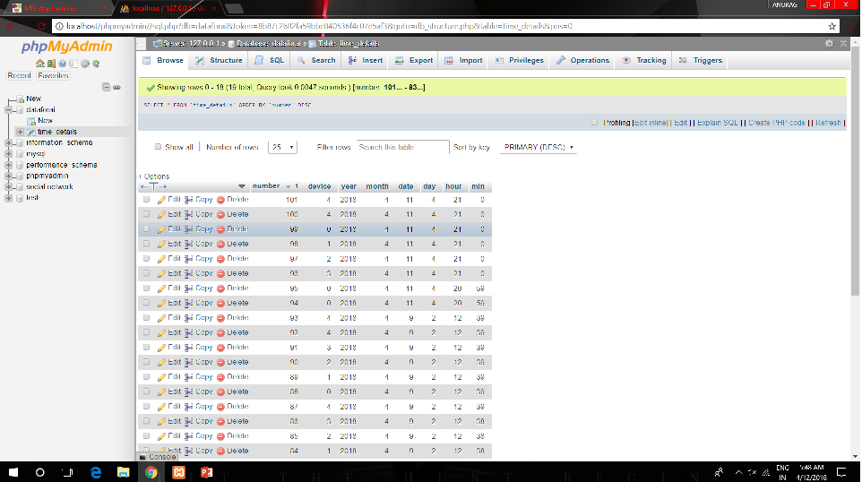
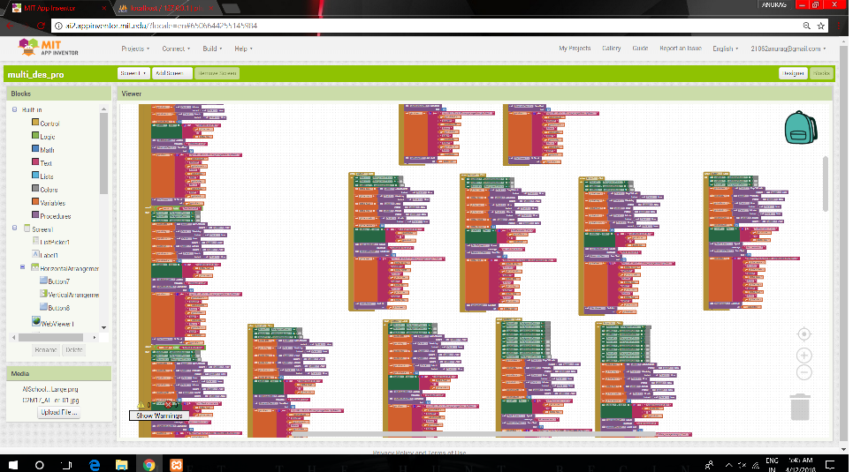
ScreenShots

Slide 15
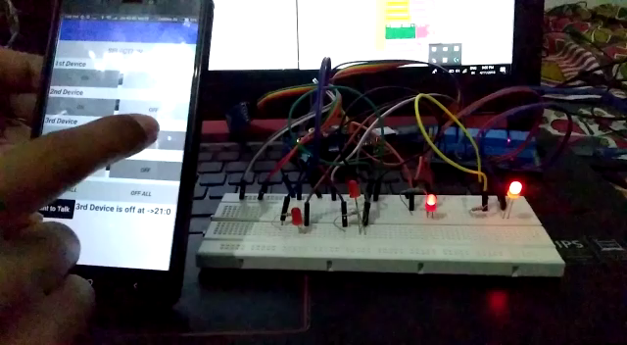
Video

Slide 16
References
https://electronicsforu.com/iot-projects-ideas
https://en.wikipedia.org/wiki/Artificial_intelligence
https://www.forbes.com/sites/freddiedawson/2016/05/24/the-house-that-learns-bringing-artificial-intelligence-into-the-home/#2defc9373fa3
https://www.tutorialspoint.com/artificial_intelligence/index.htm
https://www.wired.com/2017/06/guide-to-ai-artificial-intelligence-at-home/v
http://tvsnext.io/blog/why-artificial-intelligence-will-be-controlling-your-home-within-the-next-decade/
https://www.coursera.org/
https://www.edx.org/

